Slide 1
TABLEAU PROJECT
This complete project Is about HR ANALYSIS using data came up with the valuable insights in dashboard.
This complete dataset contains 39 columns and 1471 rows
Dataset – hr data

Slide 2
PROBLEM STATEMENTS
Employee Count
Attrition Count
Attrition Rate
Active Employees
Average Age
Attrition by Gender
Department wise Attrition
Number of Employees by Age Group
Job Satisfaction Rating
Education field wise Attrition
Attrition Rate by Gender for different age group

Slide 3
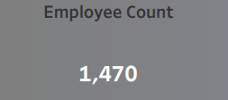
Employee Count
Insights
Total number of employees in company

Slide 4
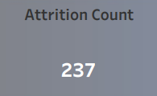
Attrition Count
Insights
Total number of employees who left the company

Slide 5
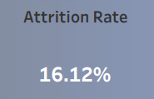
Attrition Rate
Insights
Total Rate of Attrition in company

Slide 6
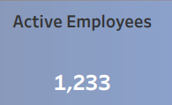
Active Employees
Insights
Total Active Employees in the company

Slide 7
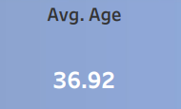
Average Age of Employees
Insights
Total Average Age of employee in company

Slide 8
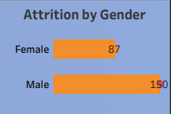
Attrition by Gender
Insights
Total Number of employees leaving the company by gender
Here we can see that male more likely to leave the company compared to the female

Slide 9
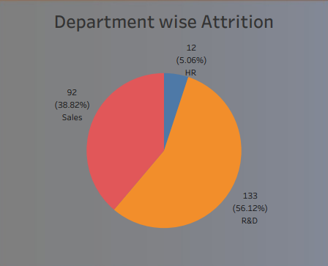
Department wise Attrition
Insights
We have three departments in dataset
HR
SALES
R&D
Details above are number of employees leaving the company according to department, here the R&D having the more attrition compare to the hr and sales.

Slide 10
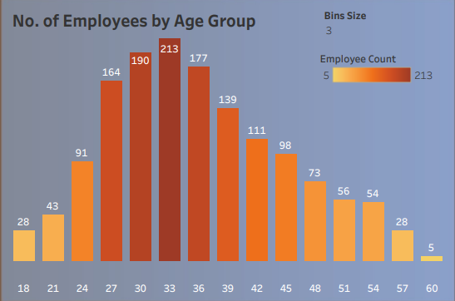
Number of Employees by Age Group
Insights
Active number of employees by age group
So here we created the parameters(i.e. bins of age) provided bins size is 3, here I use dthe filter method to show the bins according to that
Darker shade indicates the more employee count
Lighter shade indicates the less employee count
Axis provided is the age group of employees

Slide 11
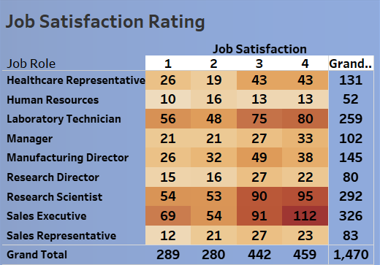
Job Satisfaction Rating
Insights
According to job role employee are satisfied with it or not, can come to know from this, i,.e in which job role how many employee are satisfied with the job.
Highest job statisfaction is in sales executive job role
Less job statisfaction is in human resoures

Slide 12
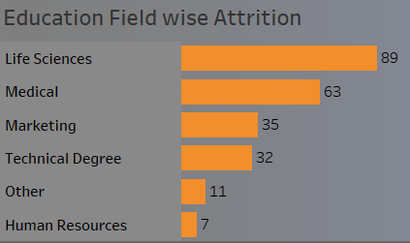
Education field wise Attrition
Insights
How many people leaving the company according to the education.
Life Sciences having more attrition compare to the other fields.

Slide 13
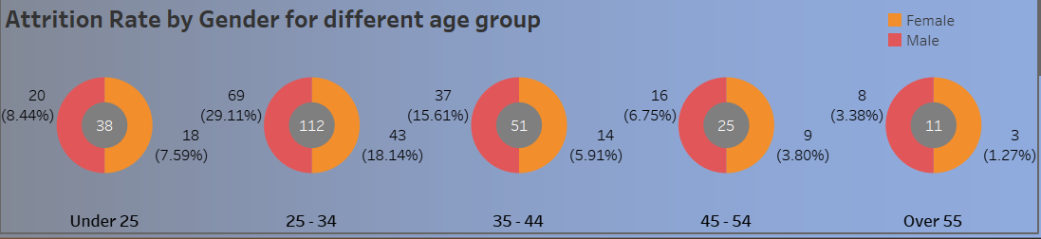
Attrition Rate by Gender for Different Age Group
Insights
Percentage of attrition by gender wise for different age group employees in the company
Here 25-34 age group having more attrition compare to the other age groups.
Lesser Over 55

Slide 14
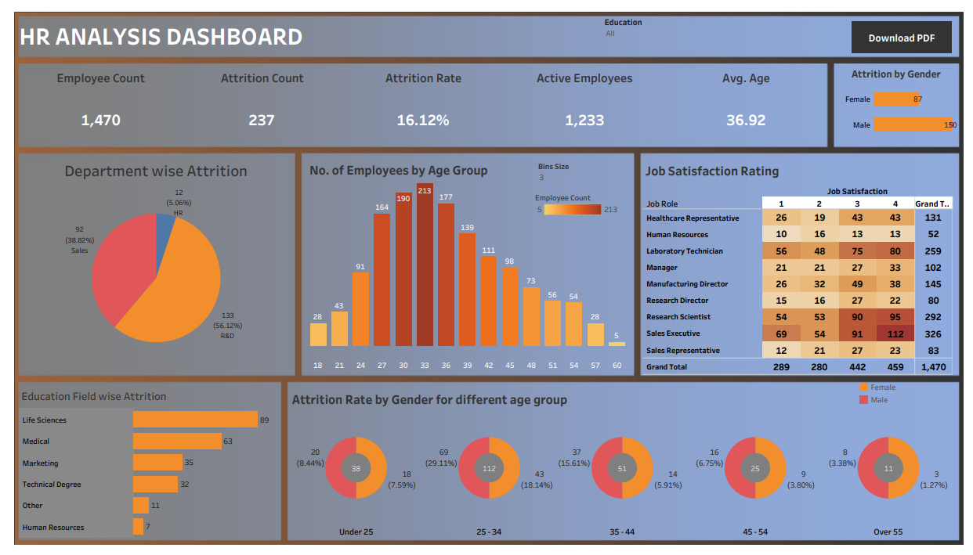
Complete Dashboard

Slide 15
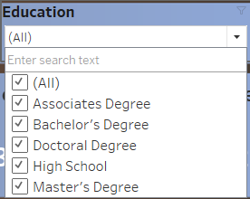
Additional Information
Filters are used according to Education
As the education type changes the dashboard going to reflect the same

Slide 16
Sources
Tableau Public Source
https://public.tableau.com/views/HRAnalysisDashboard_16792181439870/HRAnalysisDashboard?:language=en-US&publish=yes&:display_count=n&:origin=viz_share_link

Slide 17


